Slide 1
vRealize Automation Cloud and 8.0
Modern Consumption Models
Cody De Arkland
Staff, Technical Marketing Something in One of the Business Units

Slide 2
A Step Back Into the Past…
Blueprinting in vRealize Automation 8/Cloud
Enhancing Blueprints With Extensibility – ABX
vRealize Automation and Terraform
Kubernetes for the vRealize Automation User
Extending Your Deployments with Code Stream
Learning to Interact with the vRealize Automation 8/Cloud API
Automating Image Builds with Packer

Slide 3
Follow Along At -
https://github.com/codyde/cmbu-automation-masterclass

Slide 4
Stepping Back into The Past…

Slide 5
Thinking Back on a Pre vRA-Cloud World…
Catalog Focused Experience
No Canvas for Blueprinting (pre-7.x)
Application Director (Kinda multi cloud? Kinda not? Who knows…)
That Footprint! SQL, Windows, All-the-things…
Late Breaking API’s (6.?)
LAAAAAATE Breaking Terraform (7.4?)
LLAAAAAAAAAATE Breaking Clarity Refresh (7.5)

Slide 6
The Problems That Need to Be Solved Have Changed

Slide 7
Modern Consumption Models
Blueprint
API
CLI
Terraform
CI/CD
Catalog

Slide 8
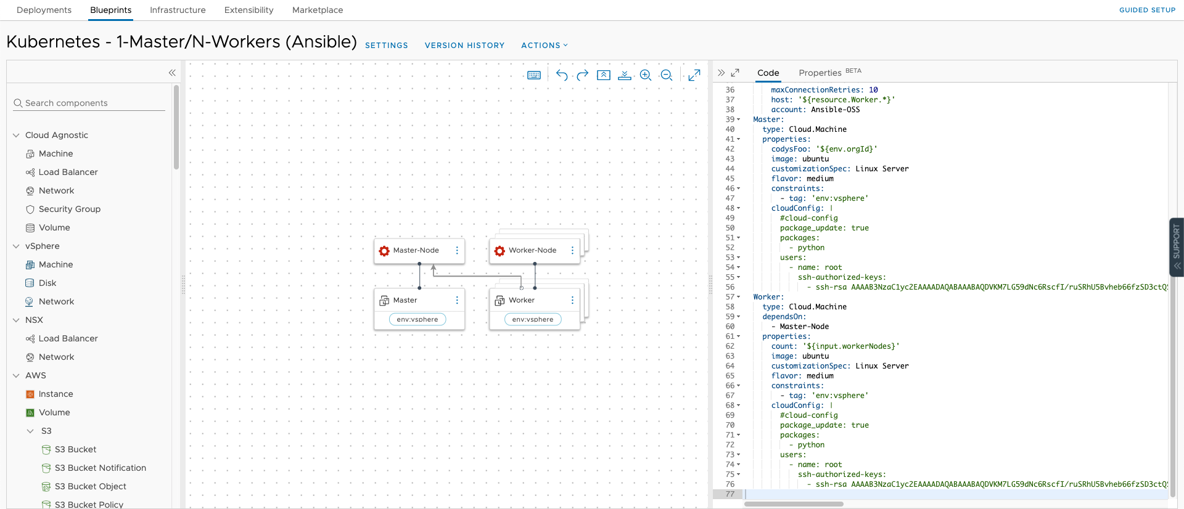
Blueprinting in Cloud Assembly

Slide 9
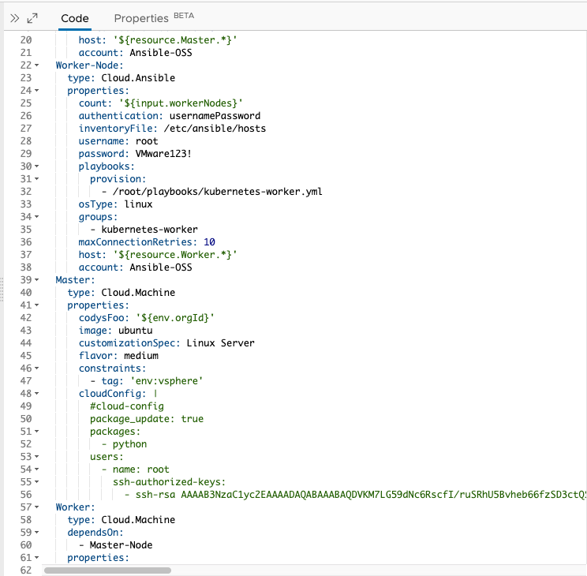
Before We Get Started… A Few Call Outs
YAML is NOT a programming language. It’s an Object Structure.
Use ‘tab’ to auto-complete fields in blueprint editor. Build muscle memory on this for demos.
Use the Property editor to visually populate fields.
Cloud Agnostic can use Cloud Specific primitives but lacks auto complete.
“Cloud Native” (Amazon DB, S3, Azure Blob, etc…) object structures can be found by looking at the respective HashiCorp Terraform objects

Slide 10
Blueprinting Deep Dive

Slide 11
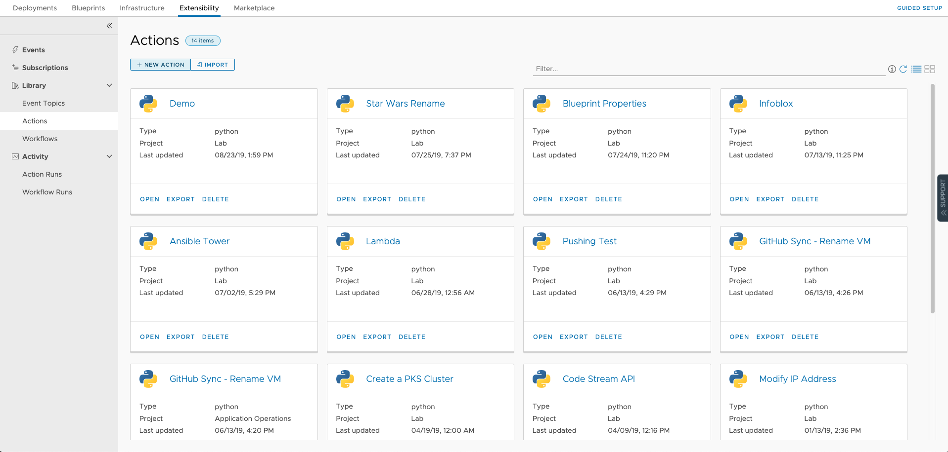
Extensibility in vRA 8 and vRA Cloud

Slide 12
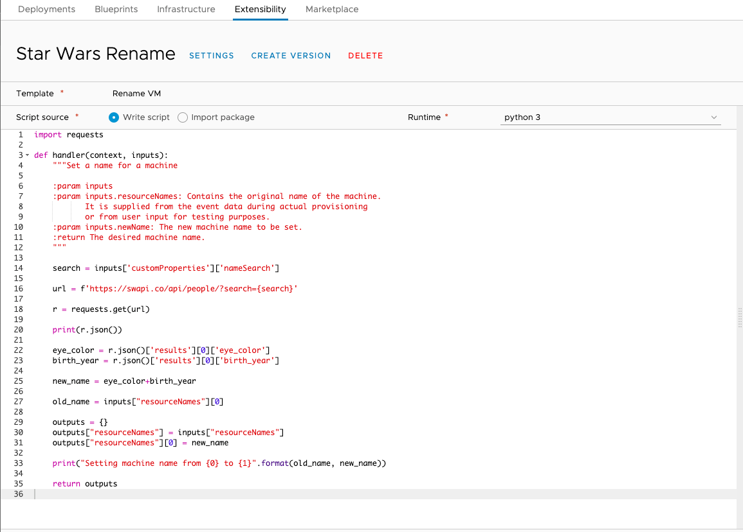
Exploring ABX for Extensibility
ABX Executes as Function as a Service
AWS = Lambda, Azure = Azure Functions, and On-Prem = Customized FaaS platform based on OpenFaaS
On premises implementation leverages a dedicated appliance known as the “Extensibility Appliance”
Quick running actions written in Python 3 and NodeJS. PowerShell is on the roadmap.

Slide 13
When vRO vs ABX?
Existing plugin support
Long running objects
Remote script execution
Dynamic Types
“Quick fire” actions
Native language support
Greenfield platform automation (especially heavy rest calls)
vRealize Orchestrator
Action Based Extensibility (ABX)

Slide 14
Hands on Exercise with ABX

Slide 15
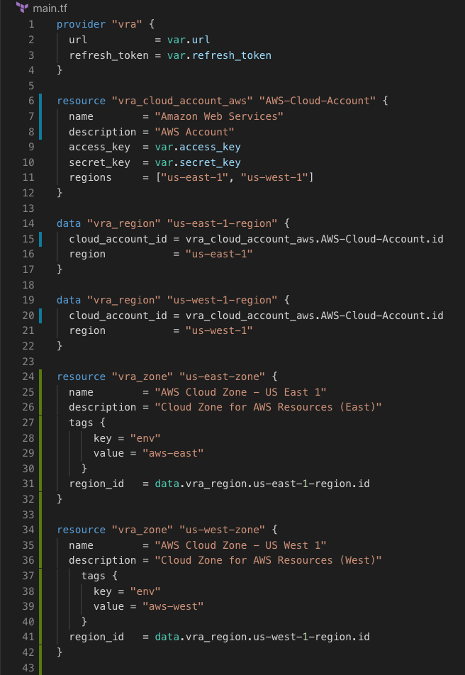
vRealize Automation Cloud/8 Terraform Provider
https://github.com/vmware/terraform-provider-vra

Slide 16
What is Terraform?
It’s not a plural (Terraforms)
An Open Source first tool for building, deploying, iterating, and destroying “things” via Infrastructure as Code
Providers enable the platform to integrate with a ”thing” (AWS, Infoblox, GitHub, etc..)
Resources are defined that deploy objects via a Provider
Data is captured that can be used as parts of other resources
Outputs can be returned to use in other resources, manifests, modules
Resulting infrastructure definitions are recorded in a State File stored locally or remotely (i.e. S3, Terraform Cloud/Enterprise)
Executes locally via a CLI tool or remotely in Terraform Cloud/Enterprise

Slide 17
What is Our Terraform Provider
https://github.com/vmware/terraform-provider-vra
A method for interacting with the IaaS API constructs in vRealize Automation Cloud via Infrastructure as Code
Currently early beta code (requires manual build of GO provider)
Quickly stage Cloud Accounts, Projects, Mappings, and Cloud Zones as code
Apply tags to associated resources
Deploy Machine and Network objects (today)

Slide 18
Terraform Provider Demo

Slide 19
Kubernetes for the vRealize Automation Administrator

Slide 20
Pro Tips!
The Integration is an Enterprise PKS integration not a Kubernetes integration (subtle difference)
Onboarding existing clusters requires connectivity to the Master node
Integration exposes high level cluster details, namespace creation, and kubeconfig download
To deploy applications to a Kubernetes cluster, add the integration to Code Stream
Leverage Git integration to create automated deployments to clusters

Slide 21
Kubernetes Walkthrough in vRealize Automation

Slide 22
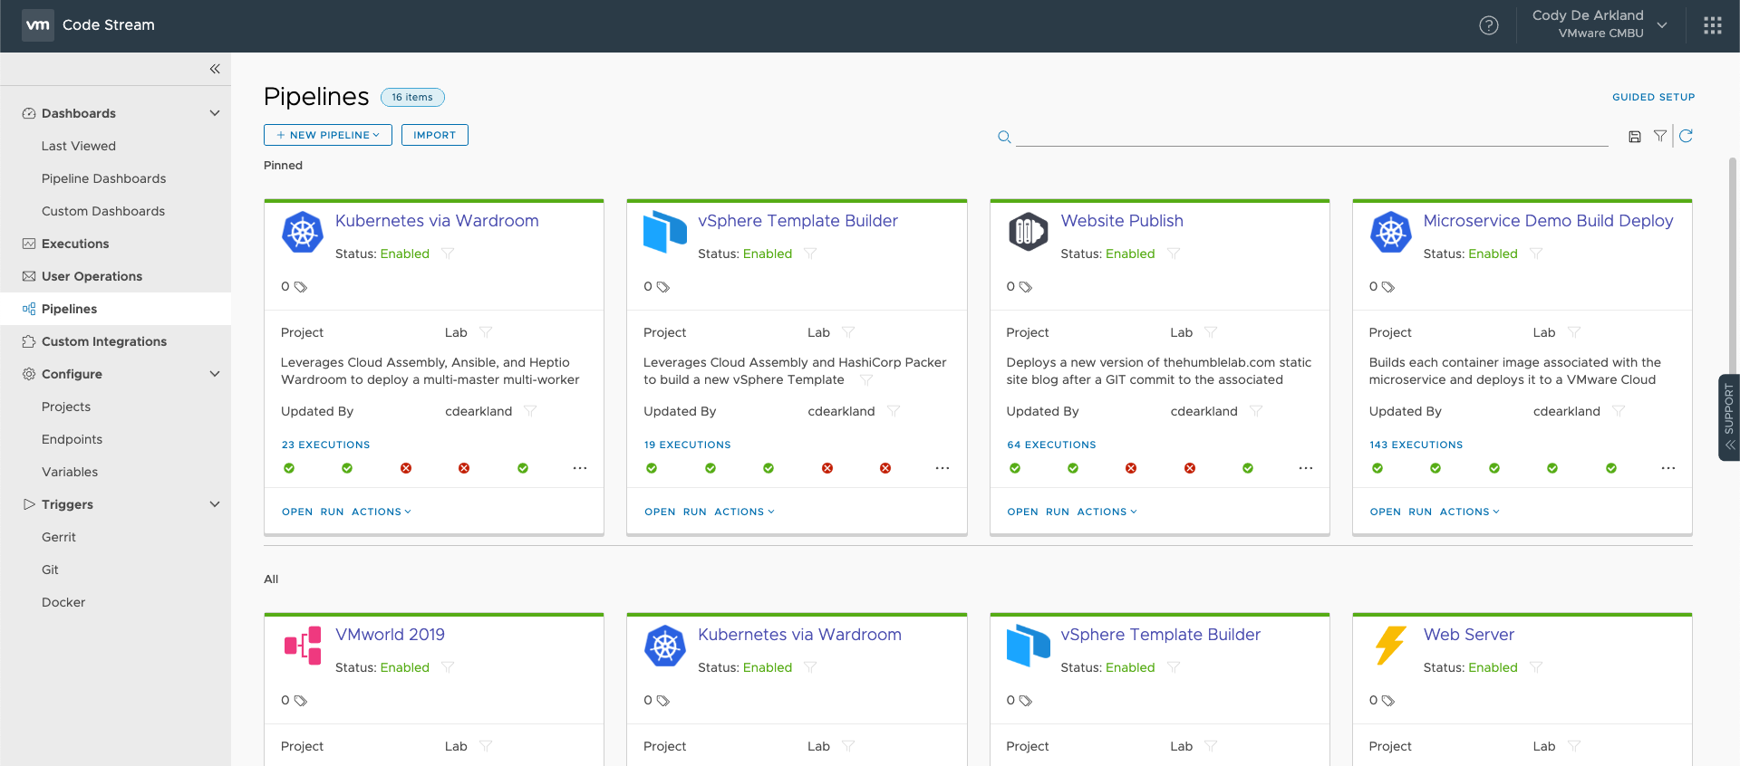
Extend your Deployments with Code Stream

Slide 23
Code Stream Pro Tips and Tricks
Understand the Workspace Tab and Builder Image/CI Capability
Enables arbitrary script/command execution against a docker image
Understand the Agent Endpoint and its capabilities
Do leverage variables
OFTEN
Do leverage Git integration to make pipelines auto-fire
Combine pipelines with Cloud Assembly deployments and Agent Endpoint for Remote SSH commands
Pay special attention to rollback pipelines – especially in Kubernetes world
AKA spend the time to clean your messes

Slide 24
Pipeline Demo Tour

Slide 25
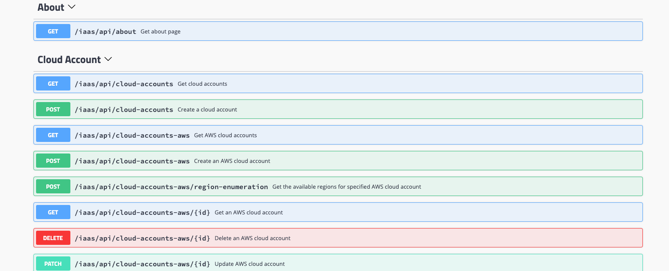
Working with vRealize Automation Cloud API

Slide 26
API Consumption Pro-Tips
Postman is your friend
Leverage the Postman Collection as a ”QuickStart”
https://github.com/vaficionado/cas-apis
May need some slight updating for recent work
Extend into languages for more extensive needs (scripts, processes, etc…)
vRealize Automation SDK for Python (aka Caspyr)
https://github.com/vmware/caspyr
Use Chrome + Developer tools to “Sniff” API examples as needed
Beware of “non-public” API’s

Slide 27
Creating API Integrations – Hands on Walkthrough

Slide 28
Automating Image Builds with Packer

Slide 29
What is Packer?
A tool for creating consistent images across multiple cloud environments
Ensures consistency by sharing the same baseline configuration manifest across each type of image creation
Combine with post-provisioners to enable cloud specific capabilities (i.e. automated convert to template in vSphere)
Sample Repo for vRealize Automation Cloud Blueprints - https://github.com/codyde/packer-vsphere-builds/tree/cas-blueprint (note the branch)

Slide 30
Packer with vSphere Demo Build

